Slide 1
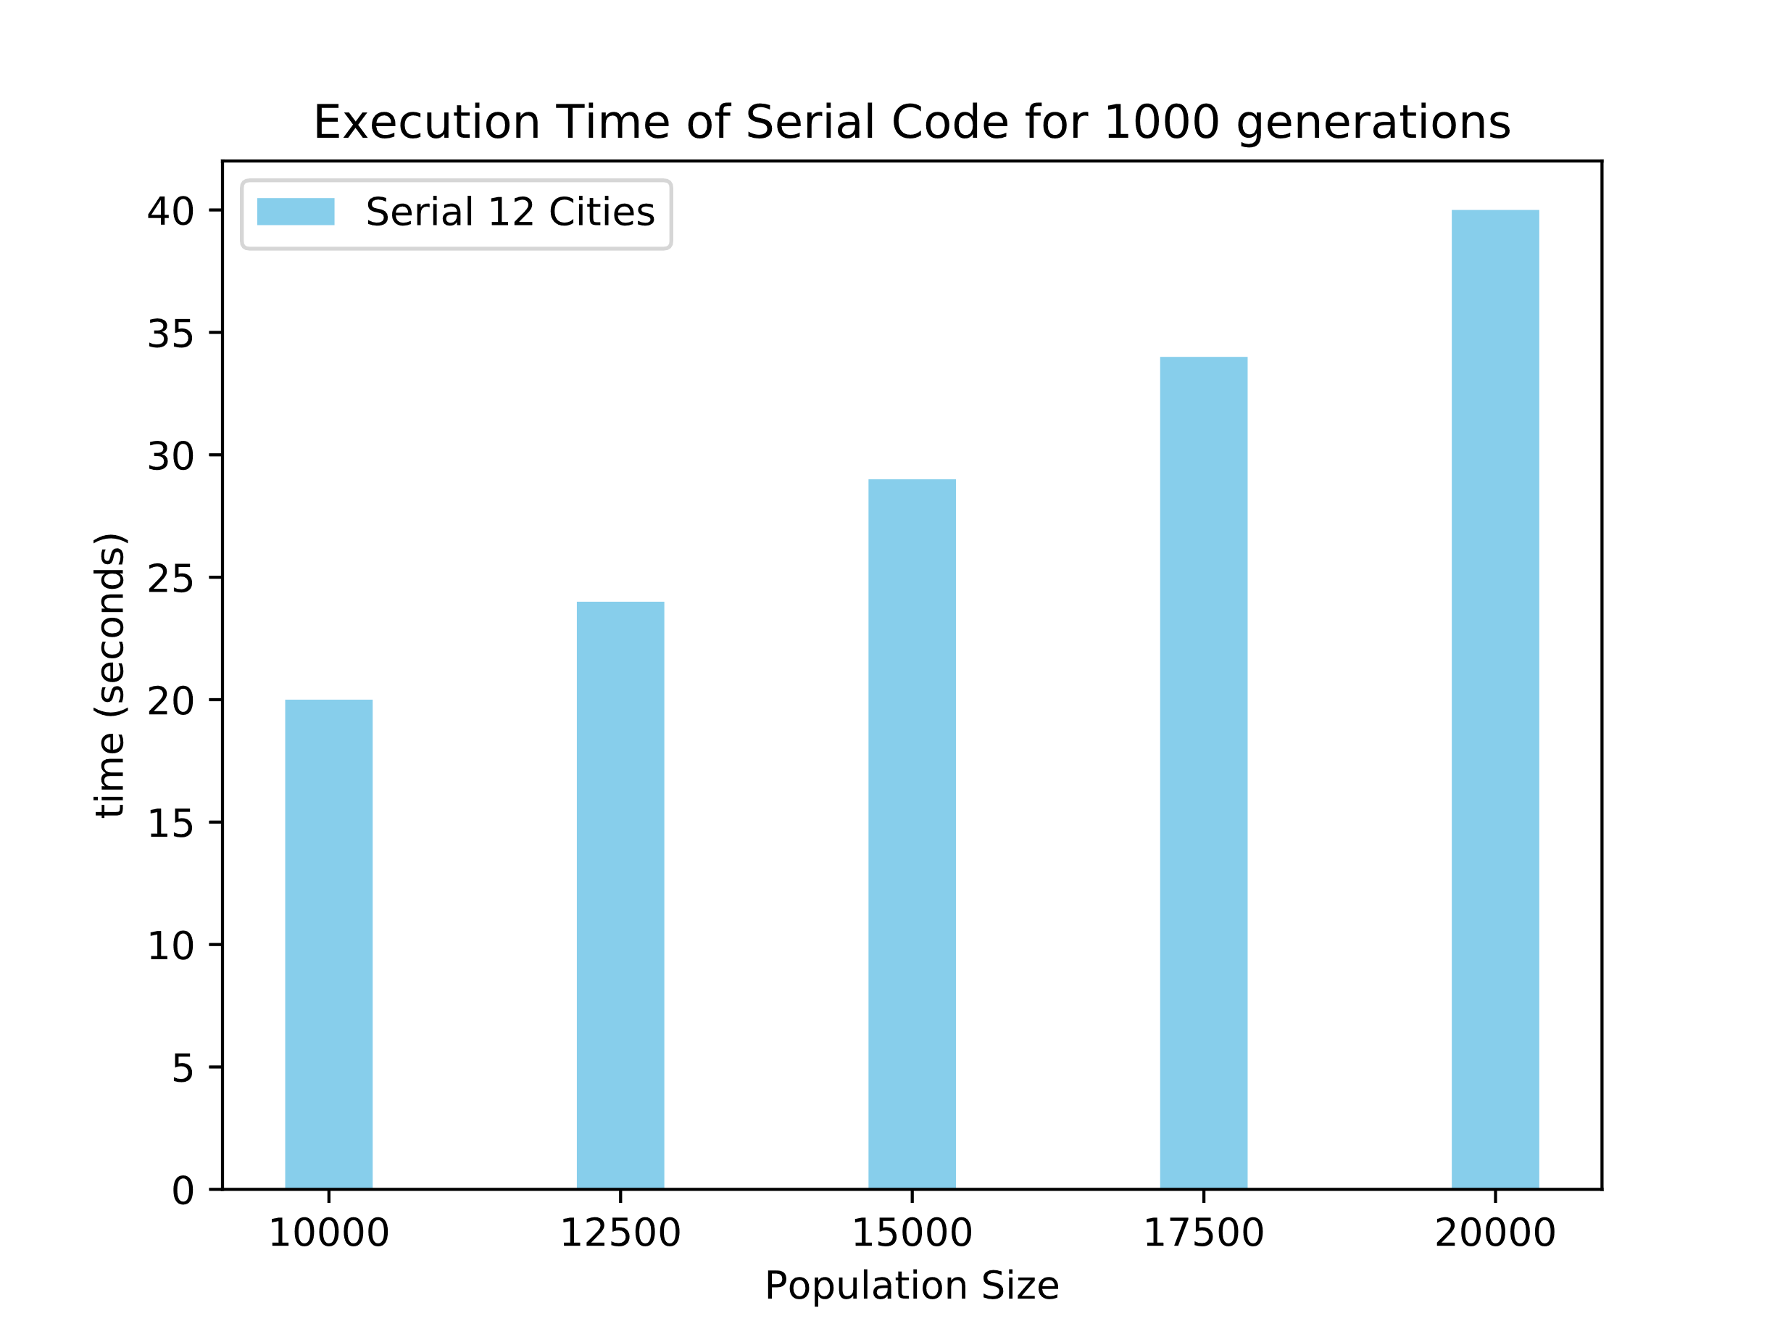
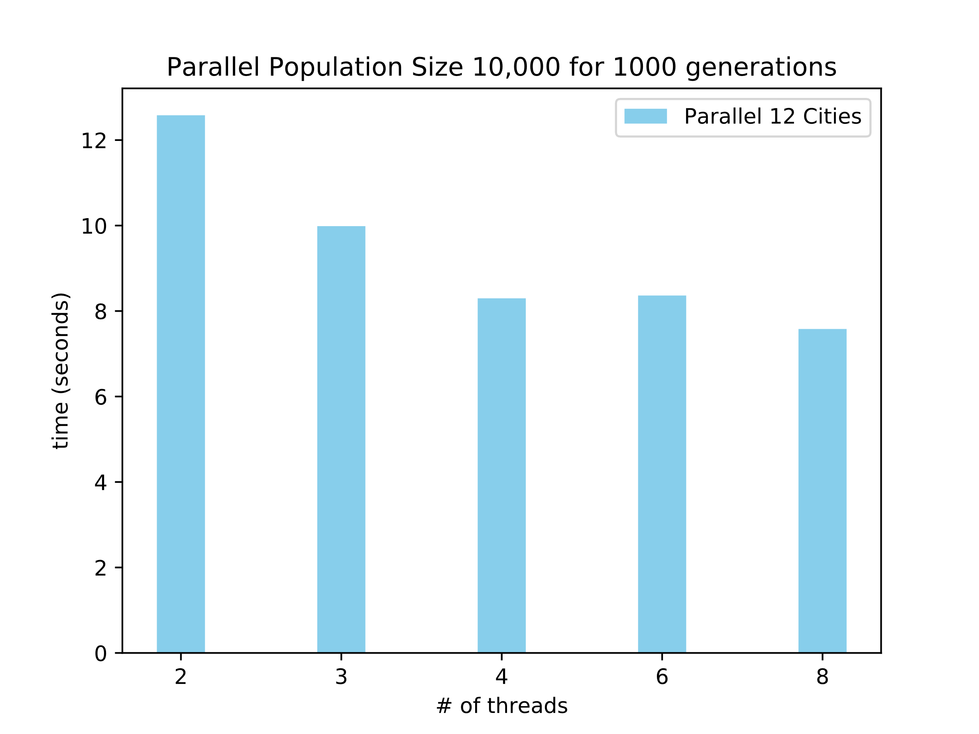
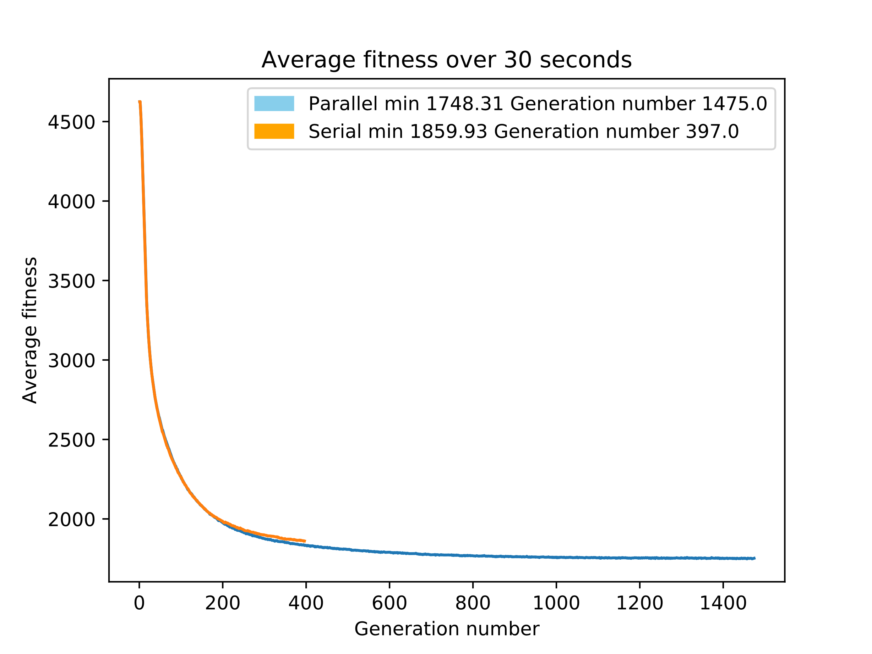
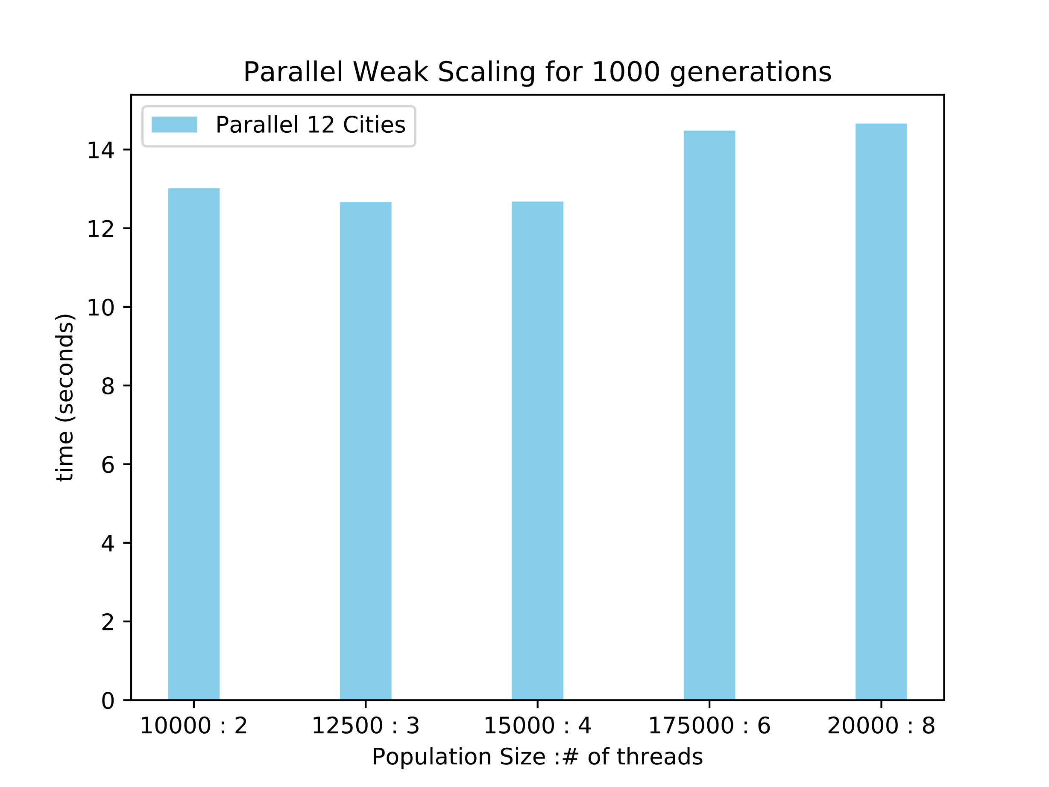


Parallel Implementation of a Genetic Algorithm
Austin Kute, David Devore – IUS Computer Science
Abstract
Our project is to implement a parallel version of a genetic algorithm to solve a Traveling Salesperson problem. The traveling salesperson problem is defined as starting at a city, travel to every other city in the graph, and end back at the starting city. The goal is to find the shortest path “cost”. Due to the nature of the genetic algorithm, the graph of cities needs to be a fully connected graph. What we will do is: implement a serial version of the algorithm, then implement a parallel version of the algorithm, and finally measure performance.
Methodology
We used OpenMP which is an application programming interface that supports shared memory parallel programming to build our project with.
We took our serial implementation and added in the appropriate calls to parallelize parts of the genetic algorithm.
Discussion
We were able to get some speed up on our parallel versus our serial implementation; however, we were not able to achieve perfect scaling on our parallel implementation. So if we increase the thread count by two we do not see a double in the performance. We were expecting to observe an improvement on the rate of decrease of the average fitness on the parallel version since it is doing more work in the same amount of time, that was not actually observed. Most likely due to the algorithm solving 29 cities in shirt amount of time.
Future Work
Optimize the code further to improve the parallel scaling. Test the algorithm for a longer period of time and on a larger city size, to see if the parallel version is able to achieve a much lower average fitness over the serial version.

